Slide 1

It‘s Time to Combine Network Advances and Databases
Helge Reelfs
CoNEXT 2016, Irvine, CA, US, December 2016
Picture from diana colors @ flickr.com

Slide 2
Databases – Where are we now?
Databases exist since 70‘s
Still very active research branch
Hardware
Software
Parallelization
Distribution (scaling out)

Slide 3
But what about networking?
Increasing line rates challenge packet processing
  CPU speeds do not scale with increasing line rates
  Performance problems at high line rates (e.g. >>10Gbps)
Main overhead factors
  Memory allocations and copy operations
  System calls and context switches
Does it matter after all?
Source: Larsen et al., “Architectural Breakdown of End-to-End Latency in a TCP/IP network, J Parallel Prog, 37:6, (2009)
Notes:
High line rates vs. small packets
Copy Operations!
Does it matter in comparison to application overhead?

Slide 4
The current answer is Remote Direct Memory Access
Local Database RDMA Cluster
TCP/IP/Ethernet Clients & Cloud
Database
Database
Caching Pool
Webserver Pool
Memcached
Webserver
Kernel
Kernel
Memcached
Webserver
NIC
NIC
NIC
NIC
Memcached
Webserver
RDMA
TCP/IP
TCP/IP
NIC
NIC
NIC
NIC
other
Kernel
Kernel
other
Database
Database
other
Other Clients
Notes:
Implementations
iWARP
InfiniBand (Verbs)
RDMA over Converged Ethernet (RoCE)
But
Software
New Paradigms
Non trivial implementation
Hardware
NIC
Networking

Slide 5
Classical Network Stack (simplified)
VALUE <key>
<value>
END
Result
Web-server
Mem-
cached
MySQL
user
remove it!
CTX SW
Copy
kernel
TRANS
NET
kernel
CTX SW
Copy
hardware
MAC
Request
GET <key>
END
Notes:
Packet Processing Engine within Kernel
Rules comprise Condition and Processor

Slide 6
Application Agnostic Packet Processor - Santa
Z
Z
Z
Mem-
cached
control plane
user
kernel
VALUE <key>
<value>
END
Result
TRANS
Santa
NET
kernel
CTX SW
Copy
hardware
MAC
Request
GET <key>
END
Notes:
Packet Processing Engine within Kernel
Rules comprise Condition and Processor

Slide 7



Preliminary Tests
4 (Memcached) or 1 (MySQL) clients
Uniform workload
(memaslap & mysqlslap)
Server + Santa Kernel
10 Gbps links
Modified Applications using Santa kernel API
  UDP Transport: Memcached
  TCP Transport: MySQL
Notes:
Each i7 4th gen 3,6GHz 8GB RAM
Intel x540 10GbE
Netgear Prosafe 10GbE Switch (copper)

Slide 8
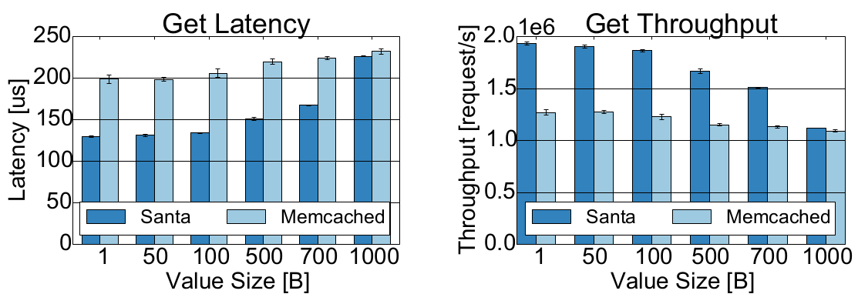

UDP Transport: Memcached Results
Motivated by real-world: very small values
*
Motivated by real-world: very small values
Santa reduces latency, increases throughput
Leveling equally @ line rate (1 KB payload)
Santa reduces latency, increases throughput
Leveling equally @ line rate (1 KB payload)
* Scaling Memcached at Facebook @ NSDI‘13
facebook logo @ facebook.com
Notes:
16 Byte random alphanumeric key
Each test 30x
Adapted Memcached using multiple UDP sockets
Memaslap

Slide 9
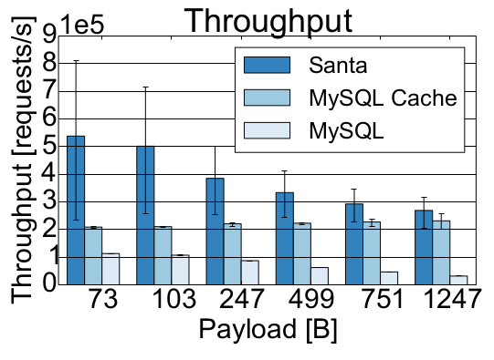
TCP Transport: MySQL Results
MySQL Query Cache is very efficient
MySQL Query Cache is very efficient
Santa further improves throughput
Leveling equally @ higher payloads
Santa further improves throughput
Leveling equally @ higher payloads
Notes:
Single indexed Inno DB table – asking for fixed amount of keys
Each test 30x
Mysqlslap

Slide 10
Future Work
Improve Santa
  Use eBPF
  Push processor down towards hardware
Evaluation of different applications
  In-Memory Database
  Distributed Database
Evaluation of Kernel-Bypassing implementations
  StackMap
Evaluation of different workloads
  Power-law
  Transactional
Evaluation of latency impact
Notes:
Application Classes
KV-Store (Memcahed)
RDBMS (MySQL, ProstgreSQ)
In-Memory (Hyrise)
Implementations
DPDK/Seastar
Netmap-based StackMap
Santa via eBPF
Workloads
Read dominant
Shift to more writes
Latency
Tail latency, Web
Latency, Transactional load

Slide 11
Thanks.
Helge Reelfs
CoNEXT 2016, Irvine, CA, US, December 2016

Slide 12
The answer is Remote Direct Memory Access
Widely used, various implementations (HPC, big databases)
Concept: lightweight direct data transfer & placement
Simple primitives (read, write, ack)
Pre-allocated buffers per connection, polling
Astonishing results (latency, throughput, CPU load)
But
  Specialized software
  Specialized hardware (NIC)
  Specialized networking infrastructure
  TCP/IP/Ethernet compatible implementations immature*
  *Zhu et al. Congestion Control for Large-Scale RDMA Deployments (SIGCOMM’15)
Notes:
Implementations
iWARP
InfiniBand (Verbs)
RDMA over Converged Ethernet (RoCE)
But
Software
New Paradigms
Non trivial implementation
Hardware
NIC
Networking

Slide 13
The good News: TCP/IP Alternatives exist!
Bypassing
Kernel
Classical
Network Stack
Kernel-
Software
APP
APP
µSTACK
user
kernel
APP
netmap / dpdk
TRANS
TRANS
TRANS
RDMA
NET
NET
NET
kernel
HW
MAC
MAC
MAC

